Slide 1
Competition and Evolutionary Models
Jason Andrews
Jeremy Goldhaber-Fiebert
May 26, 2020

Slide 2
Announcements

Slide 3
Midterm Review
Question 1c:
What is the equilibrium incidence (expressed in cases per 100,000 person-years)?
(Have reproductive number, life expectancy, and β at this point)

Slide 4
Force of Infection, Incidence, Prevalence
Force of infection = βI(t)
Incidence = βS(t)I(t)
Prevalence = I(t)
S
βSI
I

Slide 5
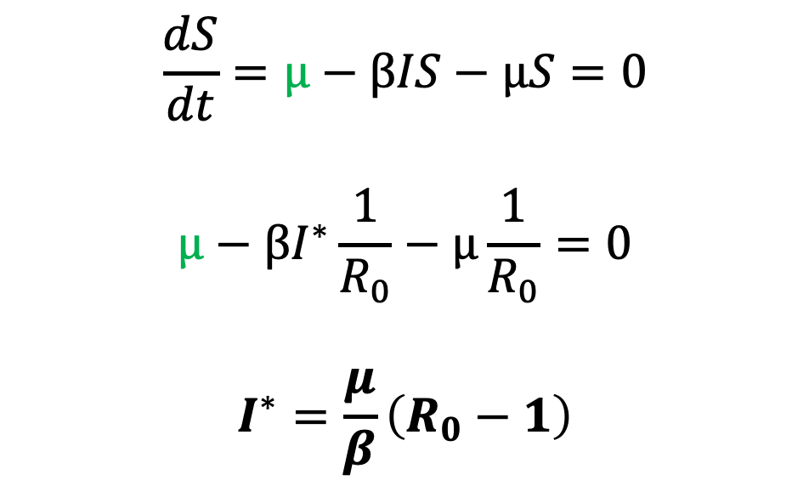
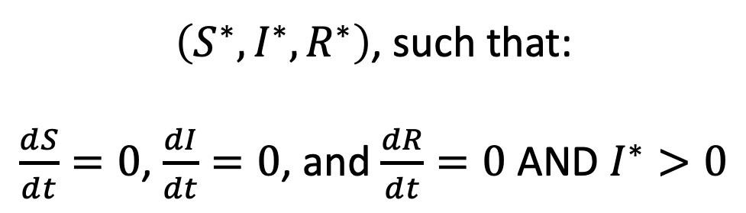
SIR model with demography: Endemic Equilibrium
$\left(S^{∗},I^{∗},R^{∗}\right)$, such that:
$\frac{dS}{dt}=0$, $\frac{dI}{dt}=0$, and $\frac{dR}{dt}=0$ AND $I^{∗}>0$
$$\frac{dS}{dt}=μ−βIS−μS=0$$
$$μ−βI^{∗}\frac{1}{R_{0}}−μ\frac{1}{R_{0}}=0$$
$$I^{∗}=\frac{μ}{β}\left(R_{0}−1\right)$$
R₀ > 1 for endemic equilibrium because
Infection must sustain itself

Slide 6
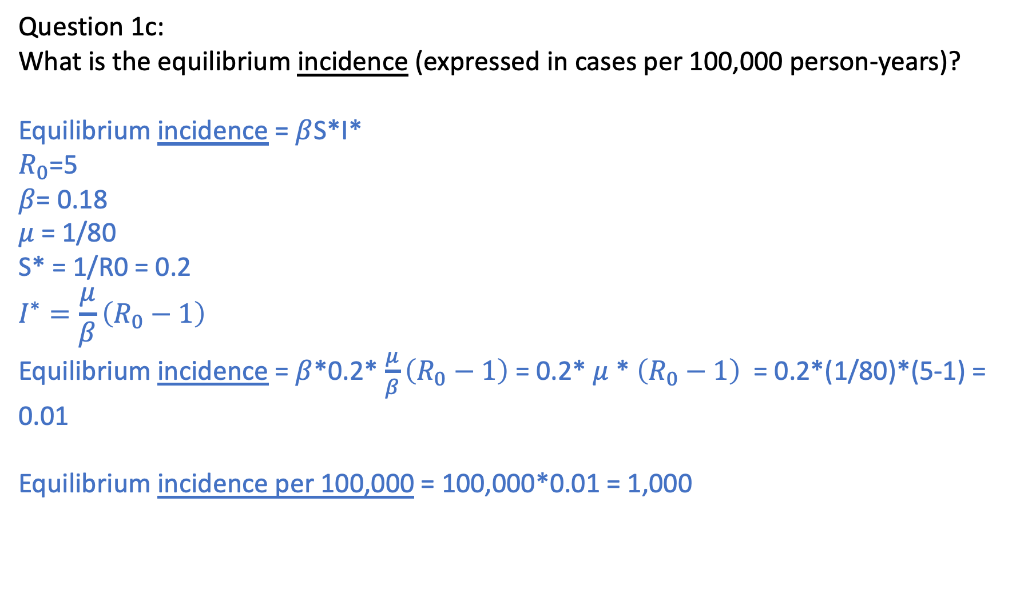
Midterm Review
Question 1c:
What is the equilibrium incidence (expressed in cases per 100,000 person-years)?
Equilibrium incidence = $β$S*I*
$R_{0}$=5
$β$= 0.18
$μ$ = 1/80
S* = 1/R0 = 0.2
$$I^{∗}=\frac{μ}{β}\left(R_{0}−1\right)$$
Equilibrium incidence = $β$*0.2* $\frac{μ}{β}\left(R_{0}−1\right)$ = 0.2* $μ$ * $\left(R_{0}−1\right)$ = 0.2*(1/80)*(5-1) = 0.01
Equilibrium incidence per 100,000 = 100,000*0.01 = 1,000

Slide 7
Midterm Review
Question 1d: What proportion of the population would have been infected by age 40?

Slide 8
Force of Infection
The force of infection (λ) is the rate at which susceptible individuals are infected.
It is a function of the proportion (or number) of infected individuals and the rate at which they infect others
We call this the effective contact rate (β)
λ(t) = βI(t)

Slide 9
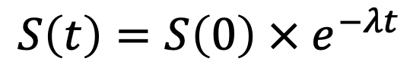
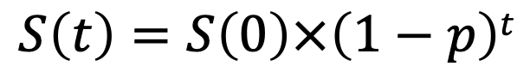
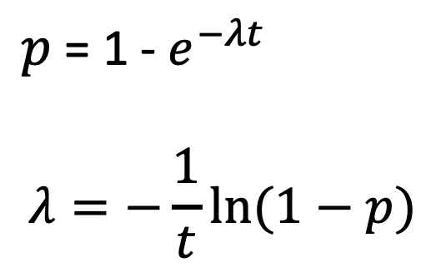
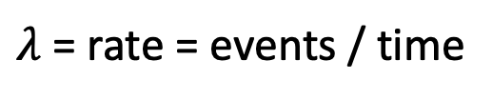
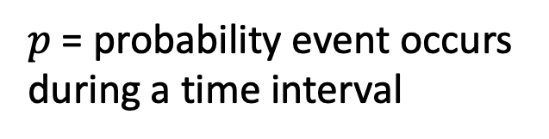
Rates versus Probabilities
$$S\left(t\right)=S\left(0\right)×\left(1−p\right)t$$
$p$= probability event occurs during a time interval
$$S\left(t\right)=S\left(0\right) × e^{−λt}$$
$λ$ = rate = events / time
$p$ = 1 - $e^{−λt}$
$$λ=−\frac{1}{t}ln⁡(1−p)$$

Slide 10
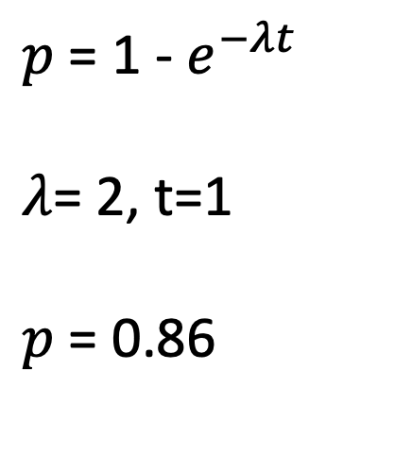
Rates versus Probabilities
Suppose on average, individuals have 2 upper respiratory infections per year. What is the probability that an individual will have at least 1 respiratory infection in a given year?
$p$ = 1 - $e^{−λt}$
$λ$= 2, t=1
$p$ = 0.86

Slide 11
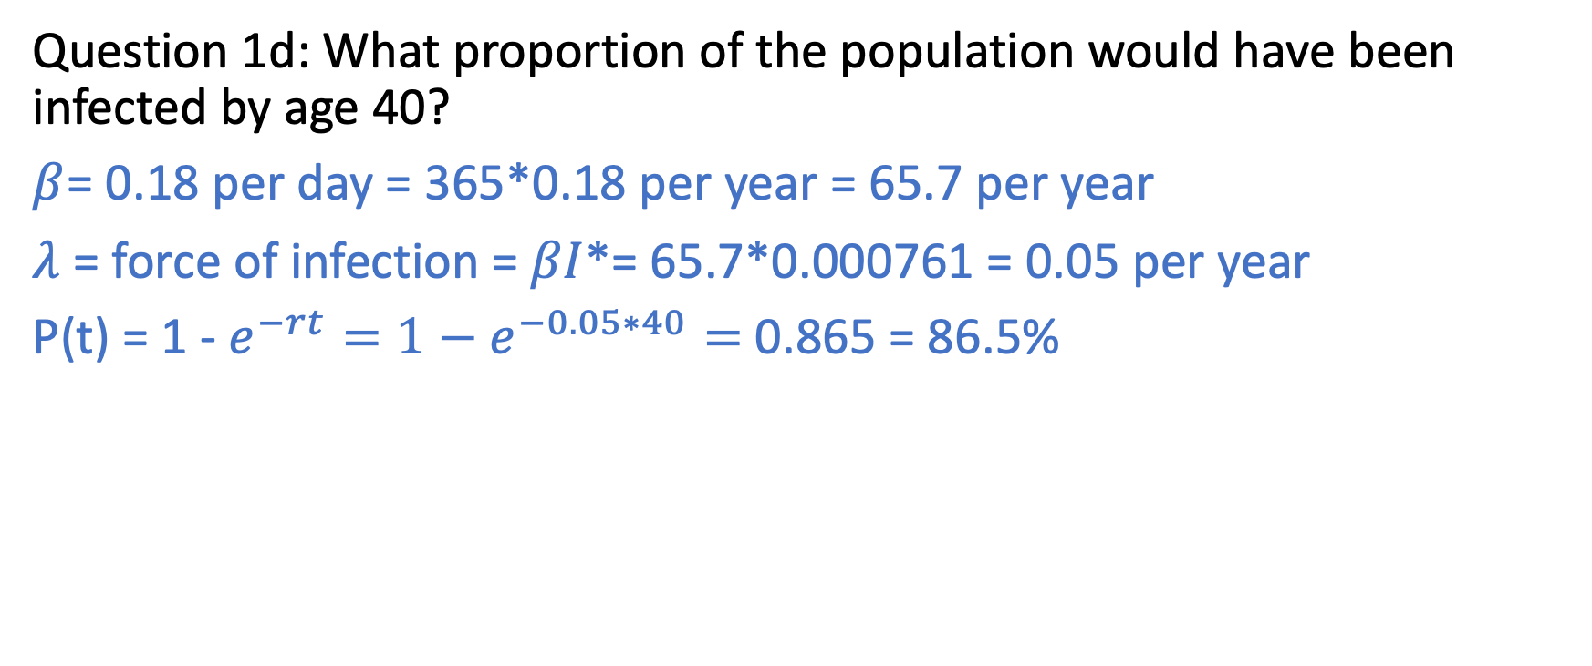
Question 1d: What proportion of the population would have been infected by age 40?
$β$= 0.18 per day = 365*0.18 per year = 65.7 per year
$λ$ = force of infection = $βI$*= 65.7*0.000761 = 0.05 per year
P(t) = 1 - $e^{−rt}=1−e^{−0.05∗40}=$0.865 = 86.5%

Slide 12
Question 2. With SARS-CoV-2, it is believed that individuals often become infectious before becoming symptomatic. Assume that the latent period is 3 days, the incubation period is 5 days, and the infectious period is 5 days. Assume that the basic reproductive number is 3, and infectiousness does not affect symptoms.

Slide 13
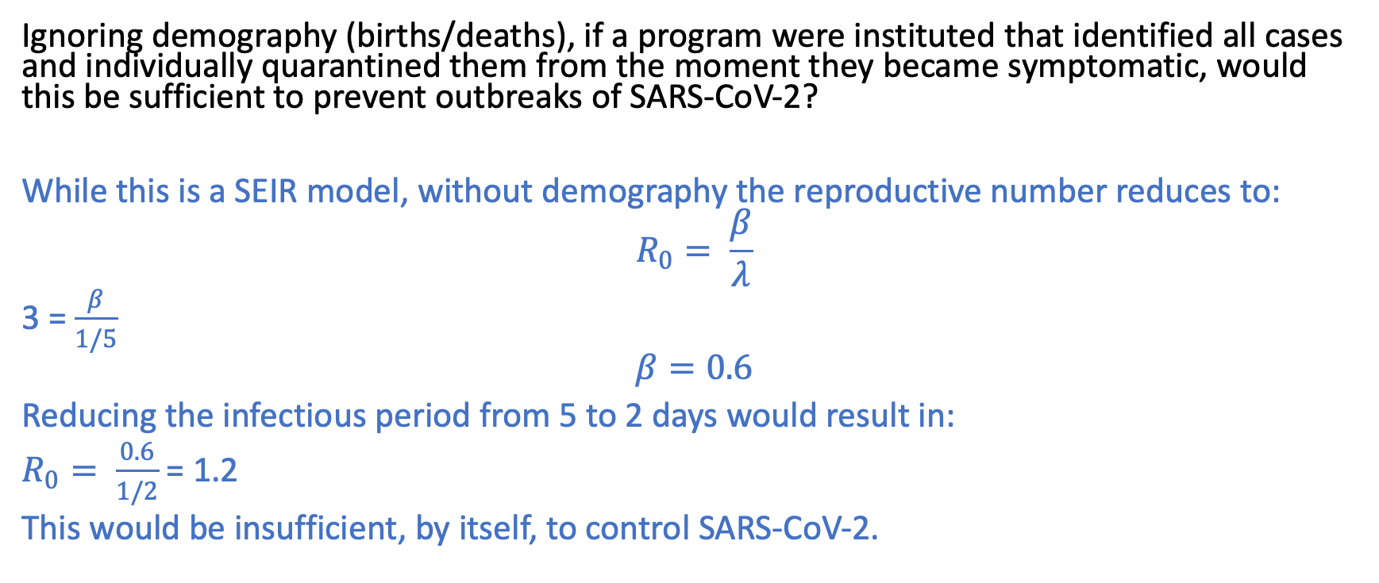
Question 2. With SARS-CoV-2, it is believed that individuals often become infectious before becoming symptomatic. Assume that the latent period is 3 days, the incubation period is 5 days, and the infectious period is 5 days. Assume that the basic reproductive number is 3, and infectiousness does not affect symptoms.
Ignoring demography (births/deaths), if a program were instituted that identified all cases and individually quarantined them from the moment they became symptomatic, would this be sufficient to prevent outbreaks of SARS-CoV-2?
While this is a SEIR model, without demography the reproductive number reduces to:
$$R_{0}= \frac{β}{λ}$$
3 = $\frac{β}{1/5}$
$$β=0.6$$
Reducing the infectious period from 5 to 2 days would result in:
$R_{0}= \frac{0.6}{1/2}$ = 1.2
This would be insufficient, by itself, to control SARS-CoV-2.

Slide 14
Competition and Evolutionary Models
Jason Andrews
Jeremy Goldhaber-Fiebert
May 26, 2020

Slide 15


Slide 16




Slide 17
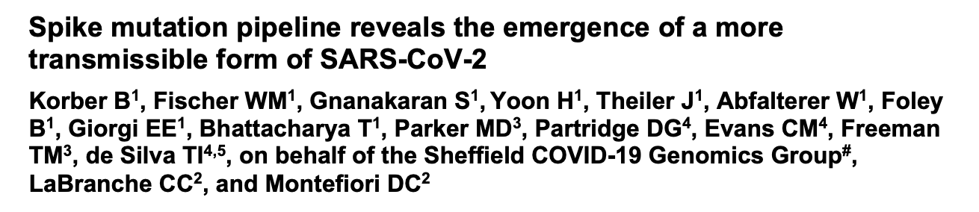
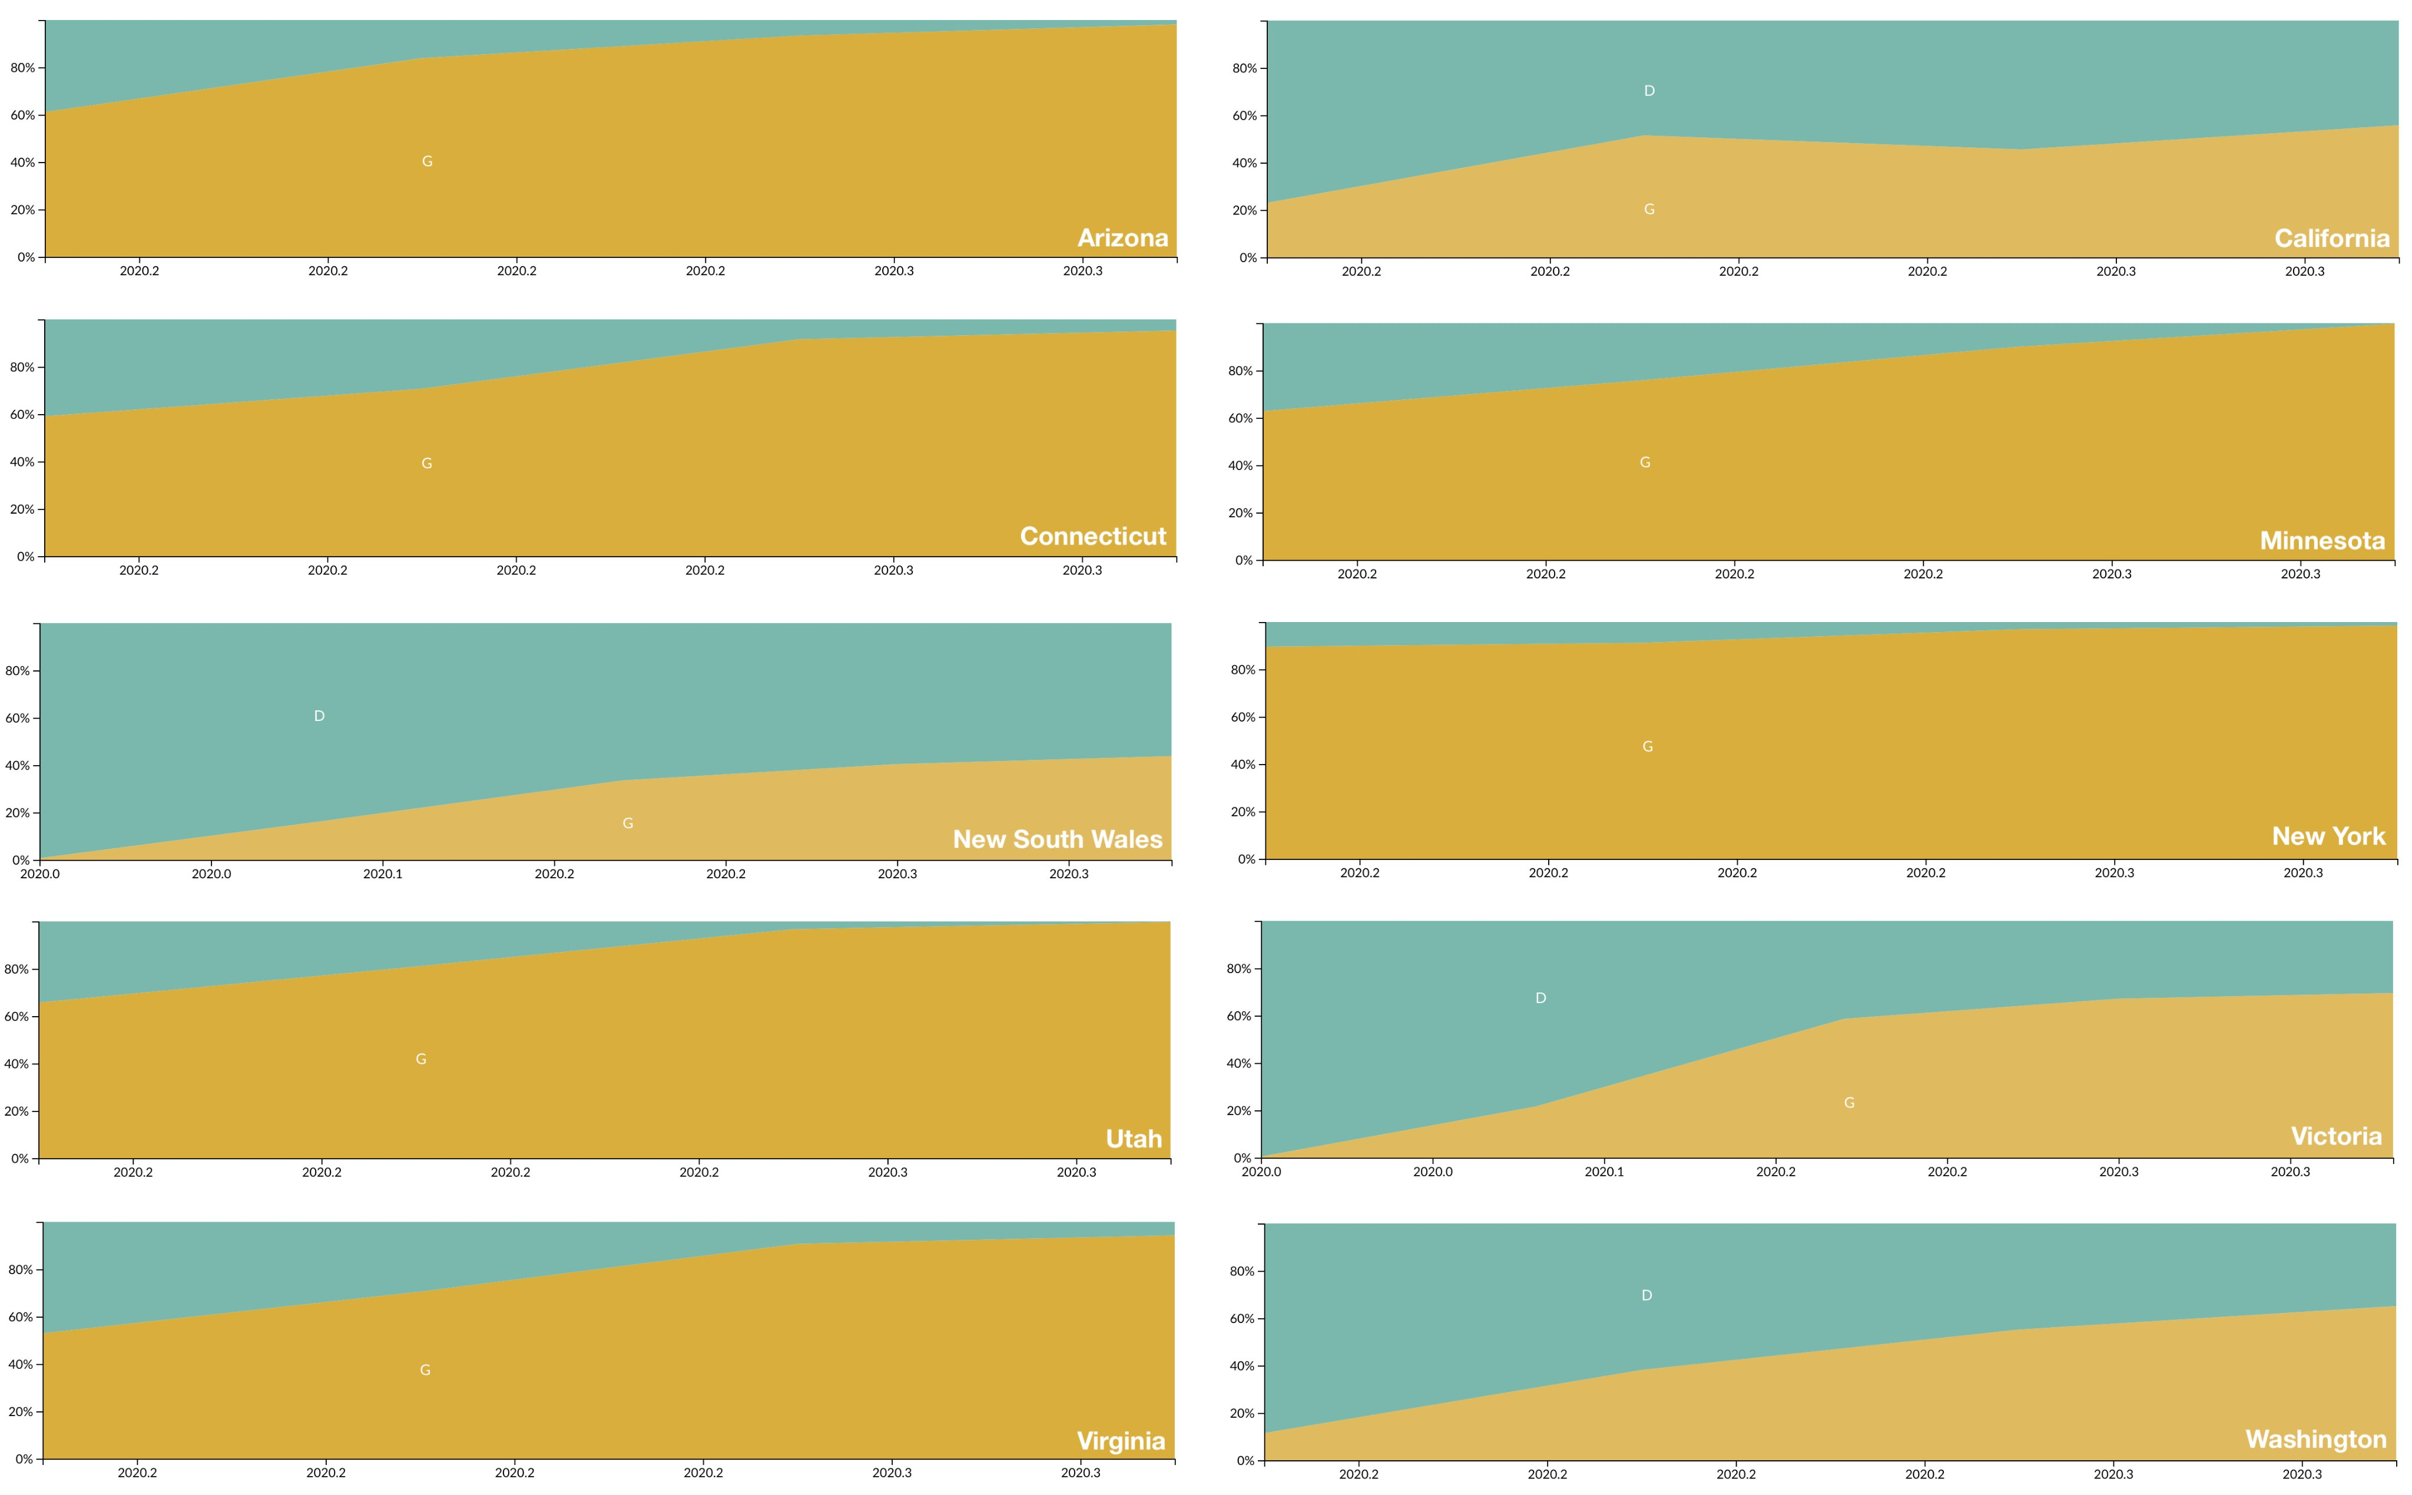
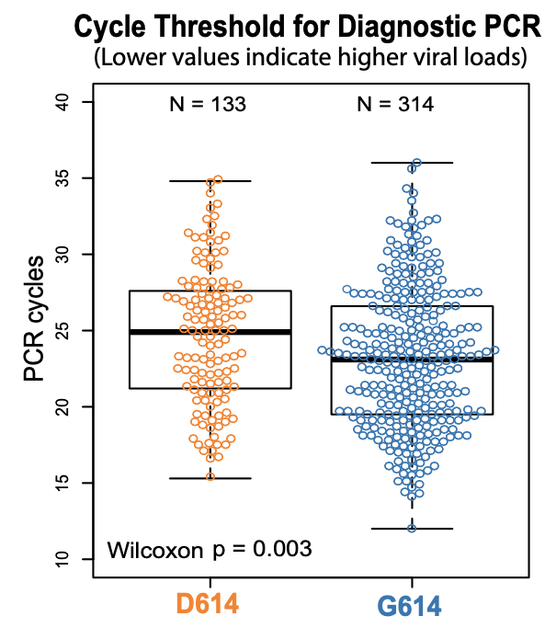

Slide 18
S 614 Mutation Global Distribution
https://nextstrain.org/ncov/global/2020-05-18
https://nextstrain.org/ncov/global/2020-05-18?c=gt-S_614&p=full

Slide 19
Questions regarding SARS-CoV-2 evolution
Will it become more fit?
Will it become more virulent?
Will it evade natural or vaccine induced immune responses?
Will it become resistant to Remdesivir?

Slide 20
Learning Objectives
Become familiar with mathematical underpinnings of the concepts of strain fitness, mutations, and adaption
Learn about how mutations enable evolution to guide adaption across fitness landscapes, and what constrains this
Understand how evolution can alter virulence of organisms and what may constrain this
Reading for today was Chapter 2 in Nowak
Will cover parts of chapter 3 and 11 (not required readings)

Slide 21
S
βSI
I
γΙ
R
infection
recovery
Until now, we’ve talked about I as a single type of unchanging organism.
What happens when there is >1 type of organism and they compete?

Slide 22
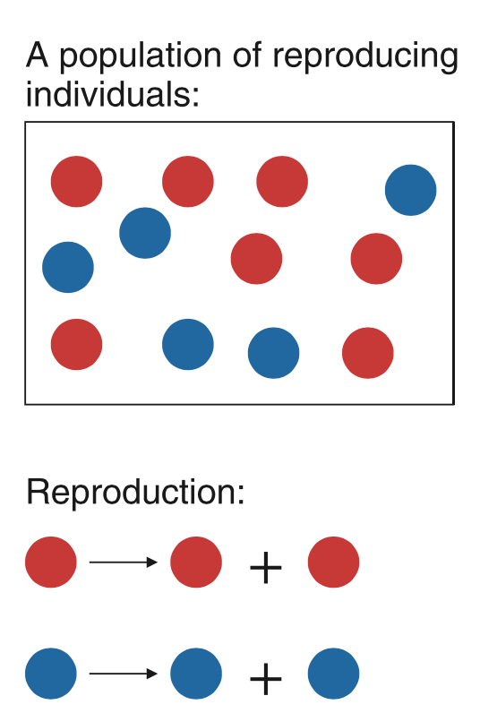
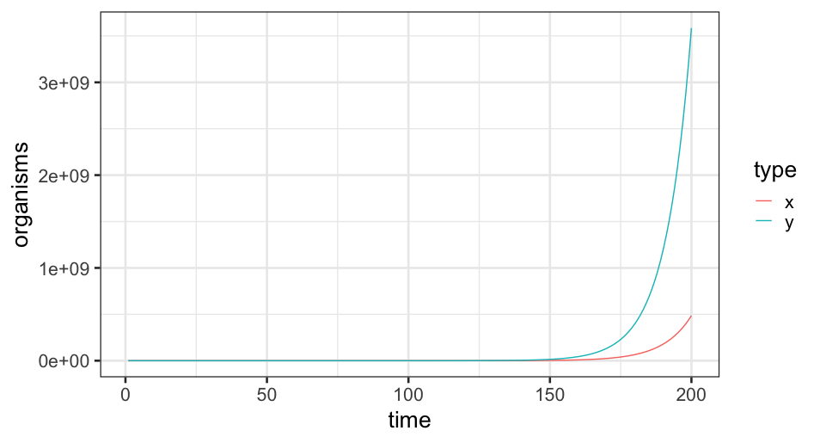
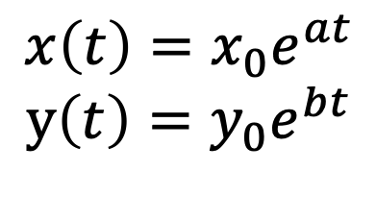
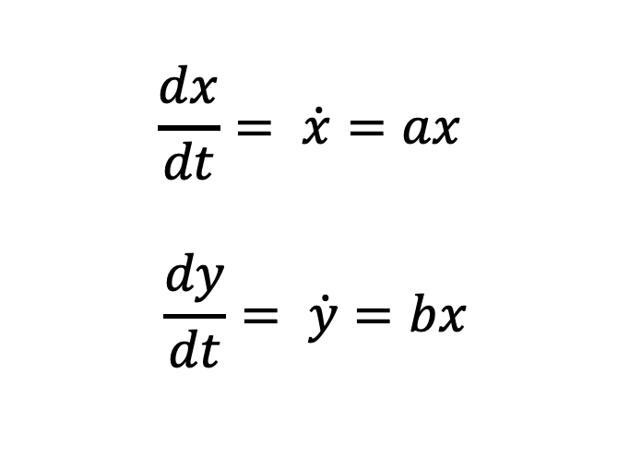
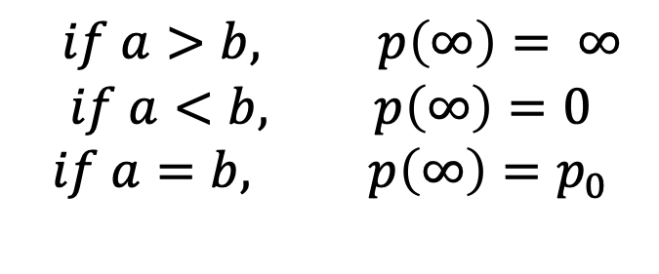
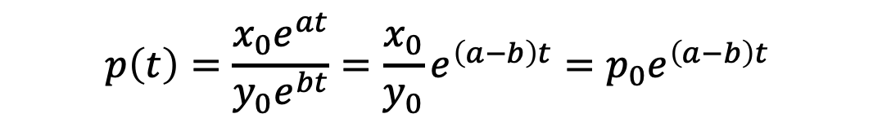
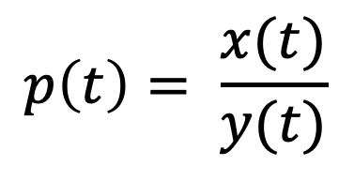
a= 0.10
b= 0.11
$$\frac{dx}{dt}= \dot{x}=ax$$
$$\frac{dy}{dt}= \dot{y}=bx$$
$$p\left(t\right)=\frac{x_{0}e^{at}}{y_{0}e^{bt}}=\frac{x_{0}}{y_{0}}e^{\left(a−b\right)t}=p_{0}e^{\left(a−b\right)t}$$
$$x\left(t\right)=x_{0}e^{at}$$
$$y\left(t\right)=y_{0}e^{bt}$$
$$p\left(t\right)= \frac{x(t)}{y(t)}$$
$$if a>b, p\left(∞\right)= ∞$$
$$if a<b, p\left(∞\right)=0$$
$$if a=b, p\left(∞\right)=p_{0}$$
Nowak, Evolutionary Dynamics

Slide 23
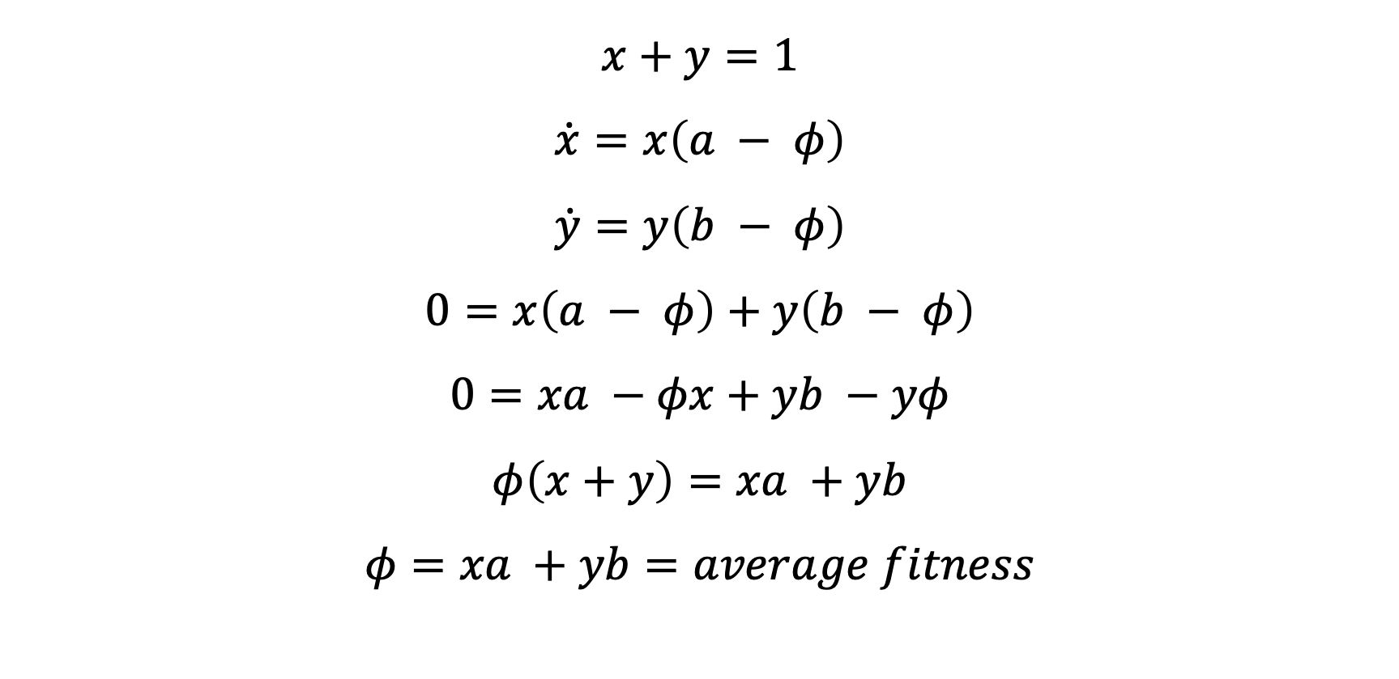
Expressing with frequencies
$$x+y=1$$
$$\dot{x}=x\left(a − φ\right)$$
$$\dot{y}=y\left(b − φ\right)$$
$$0=x\left(a − φ\right)+y\left(b − φ\right)$$
$$0=xa −φx+yb −yφ$$
$$φ\left(x+y\right)=xa +yb$$
$$φ=xa +yb=average fitness$$

Slide 24
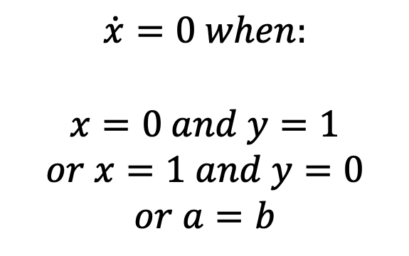
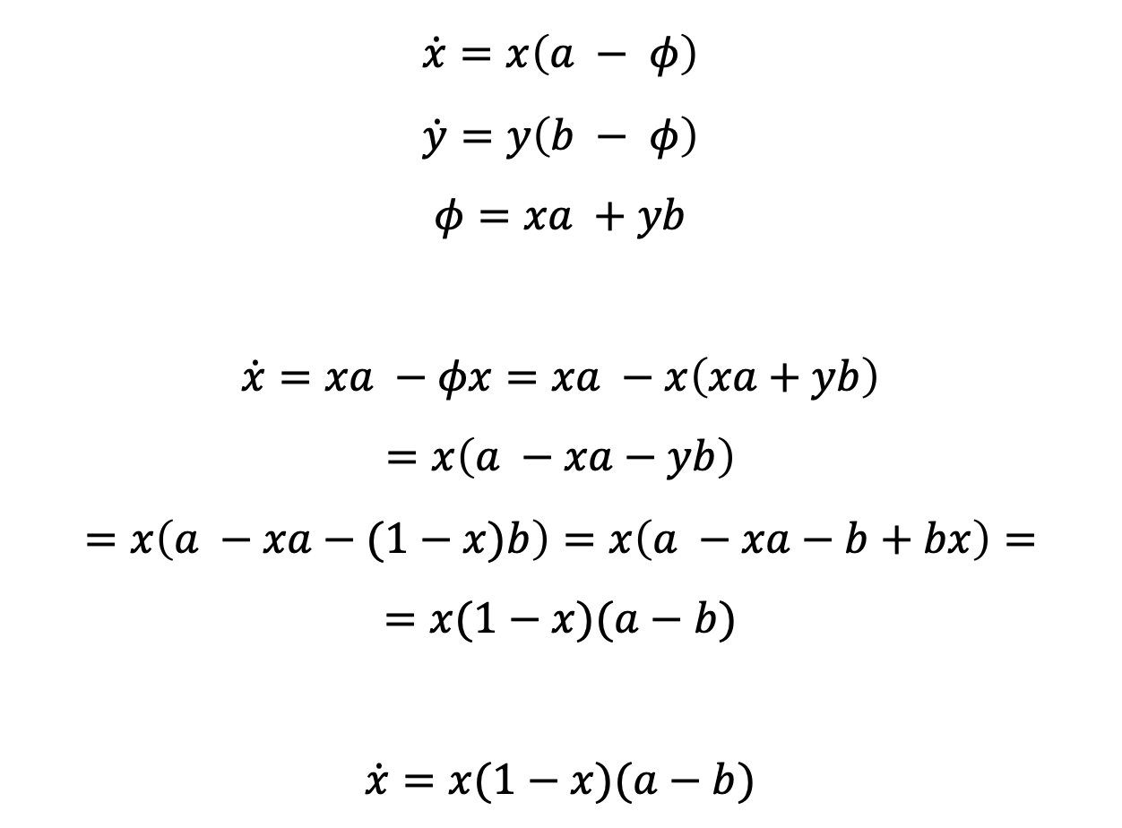
Equilibria
$$\dot{x}=x\left(a − φ\right)$$
$$\dot{y}=y\left(b − φ\right)$$
$$φ=xa +yb$$
$$\dot{x}=xa −φx=xa −x\left(xa+yb\right)$$
$$=x\left(a −xa−yb\right)$$
$$=x\left(a −xa−(1−x)b\right)=x\left(a −xa−b+bx\right)=$$
$$=x(1−x)(a−b)$$
$$\dot{x}=x(1−x)(a−b)$$
$$\dot{x}=0 when:$$
$$x=0 and y=1$$
$$or x=1 and y=0$$
$$or a=b$$
“Survival of the fitter”

Slide 25
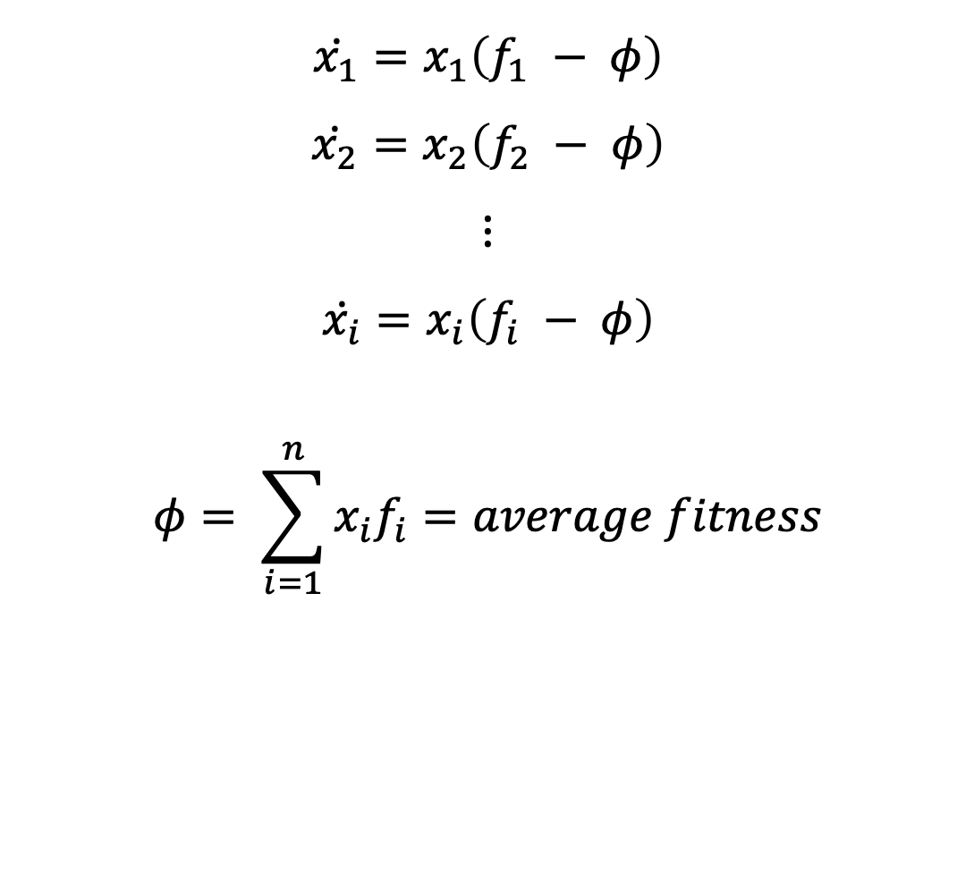
Survival of the fittest
$$\dot{x_{1}}=x_{1}\left(f_{1} − φ\right)$$
$$\dot{x_{2}}=x_{2}\left(f_{2} − φ\right)$$
$$⋮$$
$$\dot{x_{i}}=x_{i}\left(f_{i} − φ\right)$$
$$φ= \sum_{i=1}^{n}{x_{i}f_{i}}=average fitness$$

Slide 26
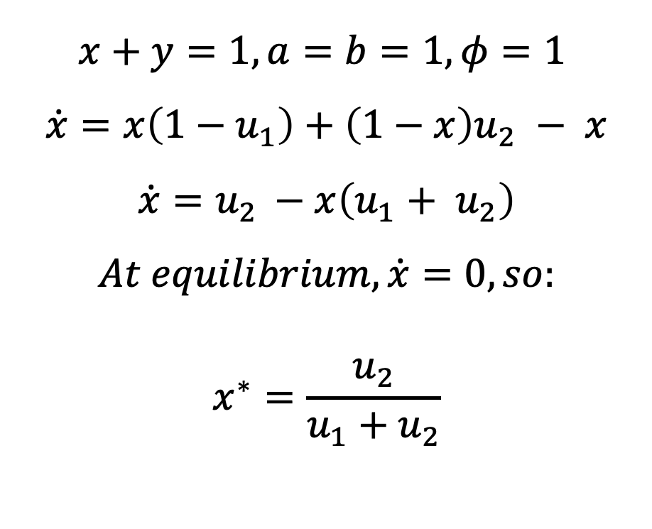
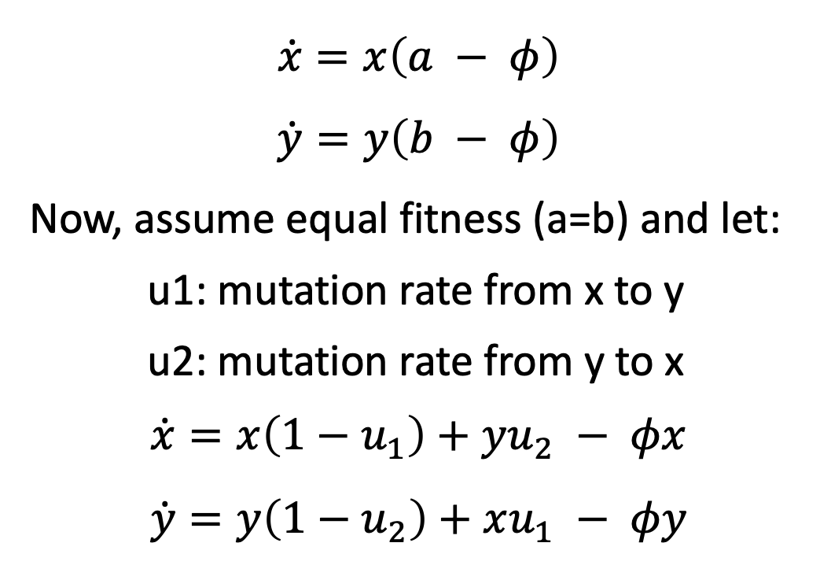
Mutations
$$x+y=1, a=b=1, φ=1$$
$$\dot{x}=x\left(1−u_{1}\right)+\left(1−x\right)u_{2} − x$$
$$\dot{x}=u_{2 }−x\left(u_{1}+ u_{2}\right)$$
$$At equilibrium,\dot{x}=0, so:$$
$$x^{∗}=\frac{u_{2}}{u_{1}+u_{2}}$$
$$\dot{x}=x\left(a − φ\right)$$
$$\dot{y}=y\left(b − φ\right)$$
Now, assume equal fitness (a=b) and let:
u1: mutation rate from x to y
u2: mutation rate from y to x
$$\dot{x}=x\left(1−u_{1}\right)+yu_{2} − φx$$
$$\dot{y}=y\left(1−u_{2}\right)+xu_{1} − φy$$

Slide 27
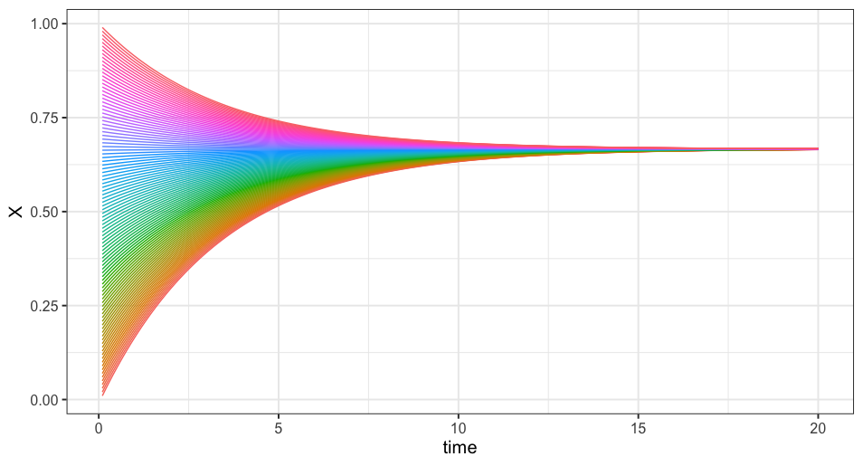
u₂ = 0.2, u₁= 0.1, x* = 2/3
Mutations in a neutral model

Slide 28
Fitness and Evolution

Slide 29
Basic Primer on Genomics and Evolution
DNA: ACTG
RNA: ACUG
ACATGCTACAGGCTACCGATCAATG
ACATGCTACAGGCTACAGATCAATG
Single Nucleotide Polymorphism (SNP)
Substitutions can be neutral or can change protein functions, sometimes changing the organism’s fitness
Substitution (mutation) rate differs between organisms
Faster for RNA than DNA

Slide 30
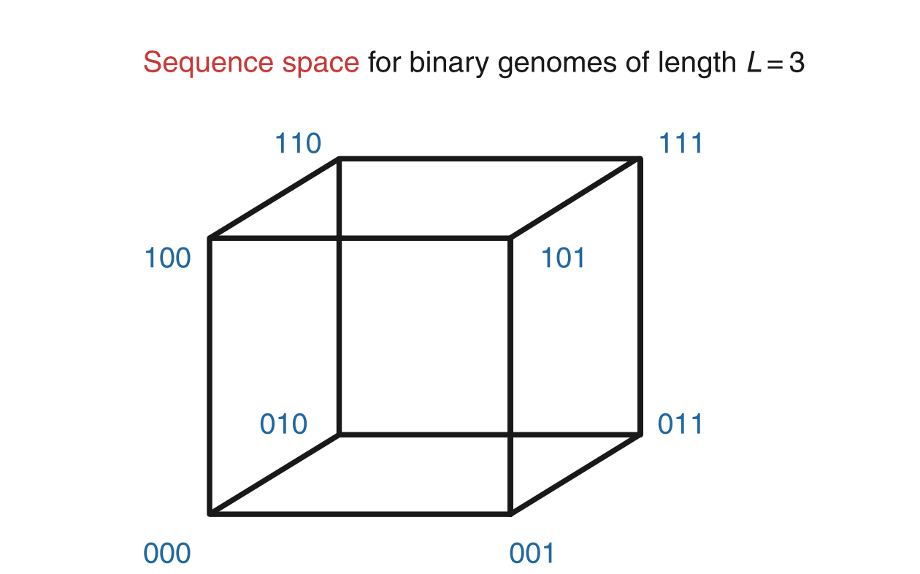
Sequence Space
100
101
110
L= length of genome
Possible sequences = 2^{L}
Viral genomes: ~20,000 base pairs
Bacterial genomes: ~5x10⁶ base pairs
Evolution navigates this massive space
Nowak, Evolutionary Dynamics

Slide 31
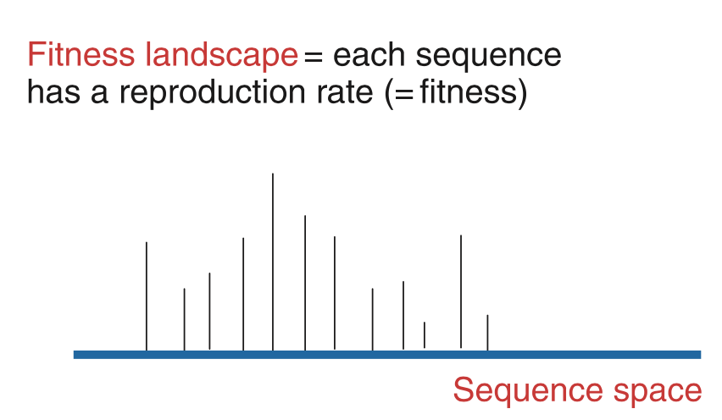
Fitness landscapes
Do species find the maximum?
Does the entire population within the species sit at the maximum?

Slide 32
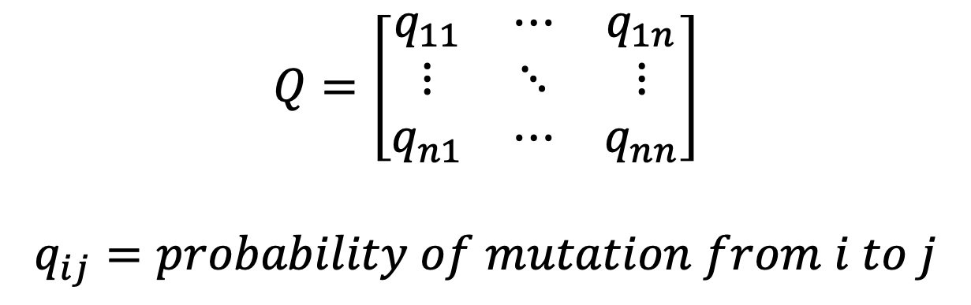
Quasispecies
“Population of self-replicating organisms with similar genomic sequences generated by mutation-selection processes”
x₀ = 0000
x₁ = 0001
x₂ = 0010
x₁₅ = 1111
$$Q=\left[\begin{matrix}q_{11} & ⋯ & q_{1n} \\ ⋮ & ⋱ & ⋮ \\ q_{n1} & ⋯ & q_{nn}\end{matrix}\right]$$
$$q_{ij}=probability of mutation from i to j$$

Slide 33
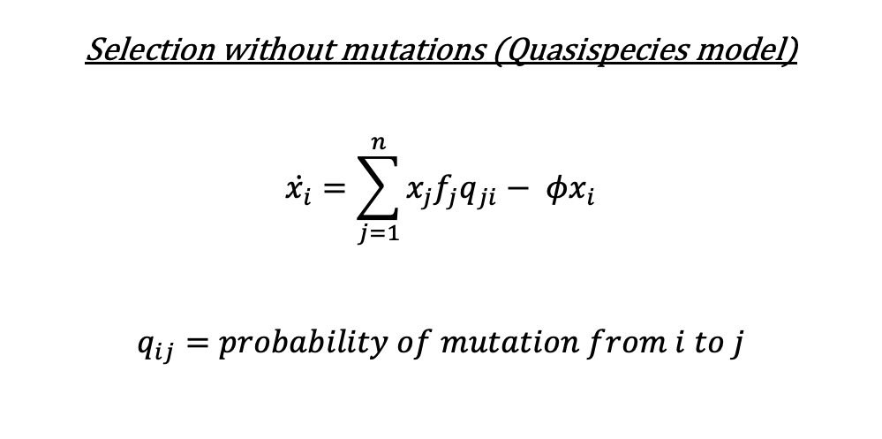
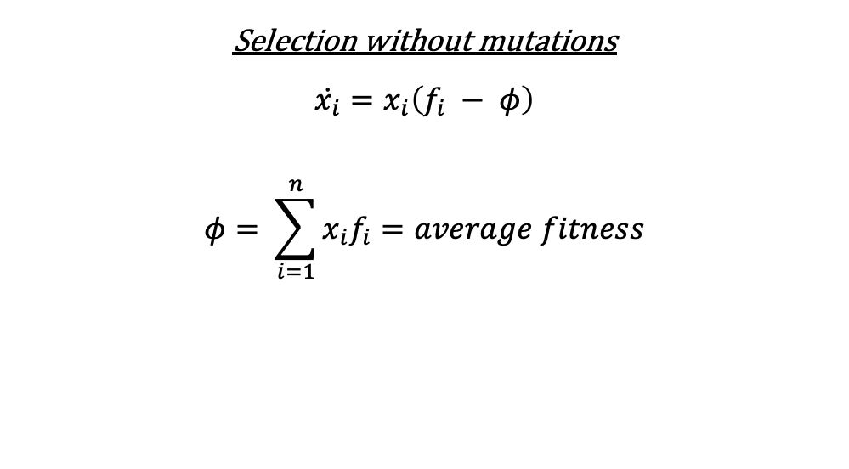
Quasispecies equation
Selection without mutations
$$\dot{x_{i}}=x_{i}\left(f_{i} − φ\right)$$
$$φ= \sum_{i=1}^{n}{x_{i}f_{i}}=average fitness$$
Selection without mutations (Quasispecies model)
$$\dot{x_{i}}=\sum_{j=1}^{n}{x_{j}f_{j}q_{ji}}− φx_{i}$$
$$q_{ij}=probability of mutation from i to j$$
If Q is identity matrix (no mutations), reduces to left side
Admits a unique, globally stable equilibrium
Equilibrium has lower average fitness than in absence of mutations

Slide 34
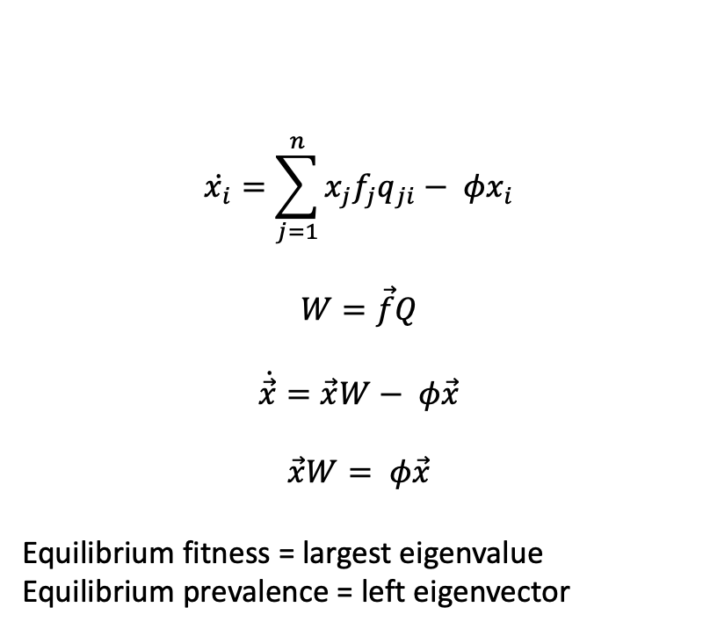
Solving for equilibrium in quasispecies equation
$$\dot{x_{i}}=\sum_{j=1}^{n}{x_{j}f_{j}q_{ji}}− φx_{i}$$
$$W=\vec{f}Q$$
$$\dot{\vec{x}}=\vec{x}W− φ\vec{x}$$
$$\vec{x}W= φ\vec{x}$$
Equilibrium fitness = largest eigenvalue
Equilibrium prevalence = left eigenvector

Slide 35
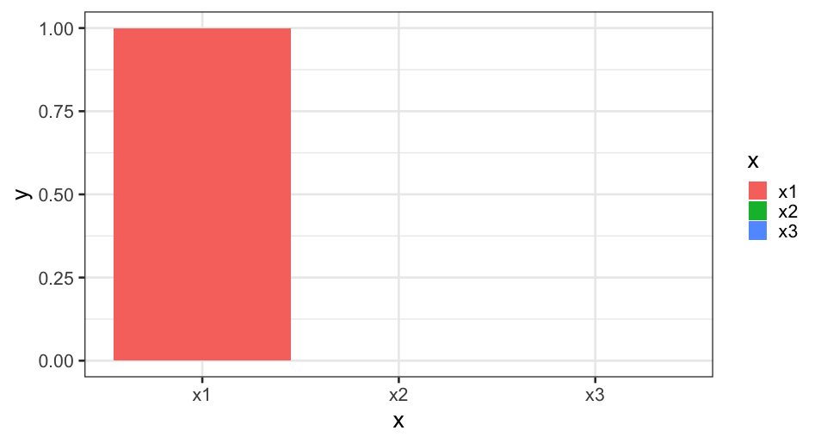
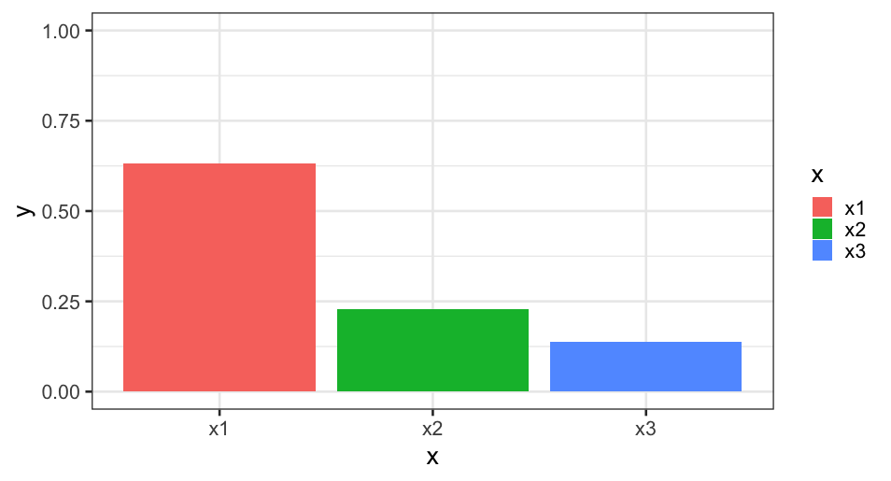
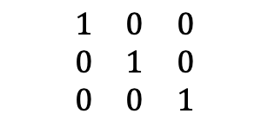

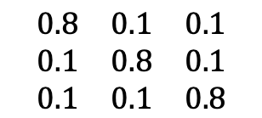
Quasispecies examples
Fitness = $\vec{f}$ = (0.3, 0.2, 0.1)
Average fitness: 0.3
$$\begin{matrix}1 & 0 & 0 \\ 0 & 1 & 0 \\ 0 & 0 & 1\end{matrix}$$
Average fitness: 0.25
$$\begin{matrix}0.8 & 0.1 & 0.1 \\ 0.1 & 0.8 & 0.1 \\ 0.1 & 0.1 & 0.8\end{matrix}$$

Slide 36
If mutations lead to a lower equilibrium fitness, why have mutations?
Do faster mutation rates navigate better to fitness maxima?

Slide 37
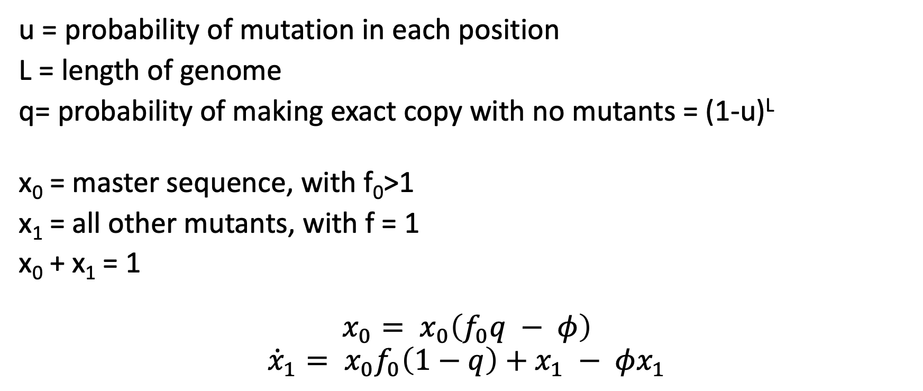
Mutations across the genome
x(t=0)= 1011
x(t=1)= 1011
u = probability of mutation in each position
L = length of genome
q= probability of making exact copy with no mutants = (1-u)^{L}
x₀ = master sequence, with f₀>1
x₁ = all other mutants, with f = 1
x₀ + x₁ = 1
$$x_{0}= x_{0}\left(f_{0}q − φ\right)$$
$${\dot{x}}_{1}= x_{0}f_{0}\left(1−q\right)+x_{1} − φx_{1}$$

Slide 38
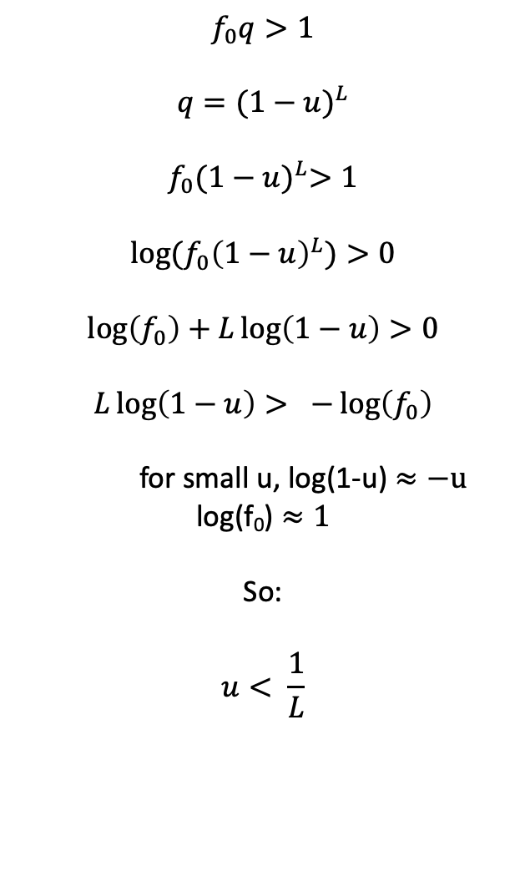
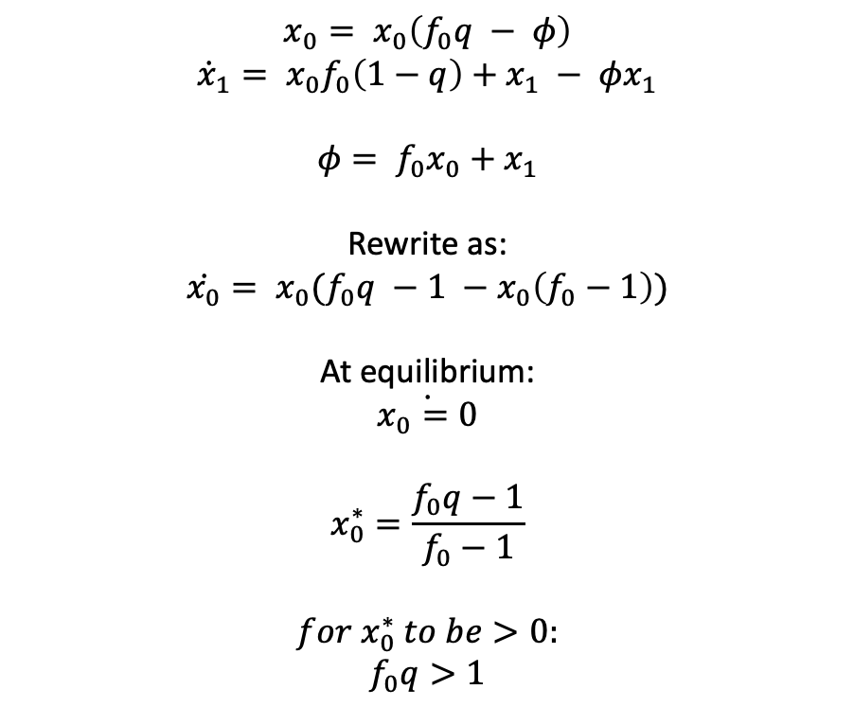
Constraints on mutation rates
$$f_{0}q>1$$
$$q={(1−u)}^{L}$$
$$f_{0}{(1−u)}^{L}>1$$
$$log⁡(f_{0}{\left(1−u\right)}^{L})>0$$
$$\log\left(f_{0}\right)+L\log\left(1−u\right)>0$$
$$L\log\left(1−u\right)> −\log\left(f_{0}\right)$$
for small u, log(1-u) $≈−u$
log(f₀) $≈1$
So:
$$u< \frac{1}{L}$$
$$x_{0}= x_{0}\left(f_{0}q − φ\right)$$
$${\dot{x}}_{1}= x_{0}f_{0}\left(1−q\right)+x_{1} − φx_{1}$$
$$φ= f_{0}x_{0}+x_{1}$$
Rewrite as:
$$\dot{x_{0}}= x_{0}(f_{0}q −1 −x_{0}\left(f_{0}−1\right))$$
At equilibrium:
$$\dot{x_{0}=0}$$
$$x_{0}^{∗}=\frac{f_{0}q−1}{f_{0}−1}$$
$$for{ x}_{0}^{∗} to be>0:$$
$$f_{0}q>1$$

Slide 39
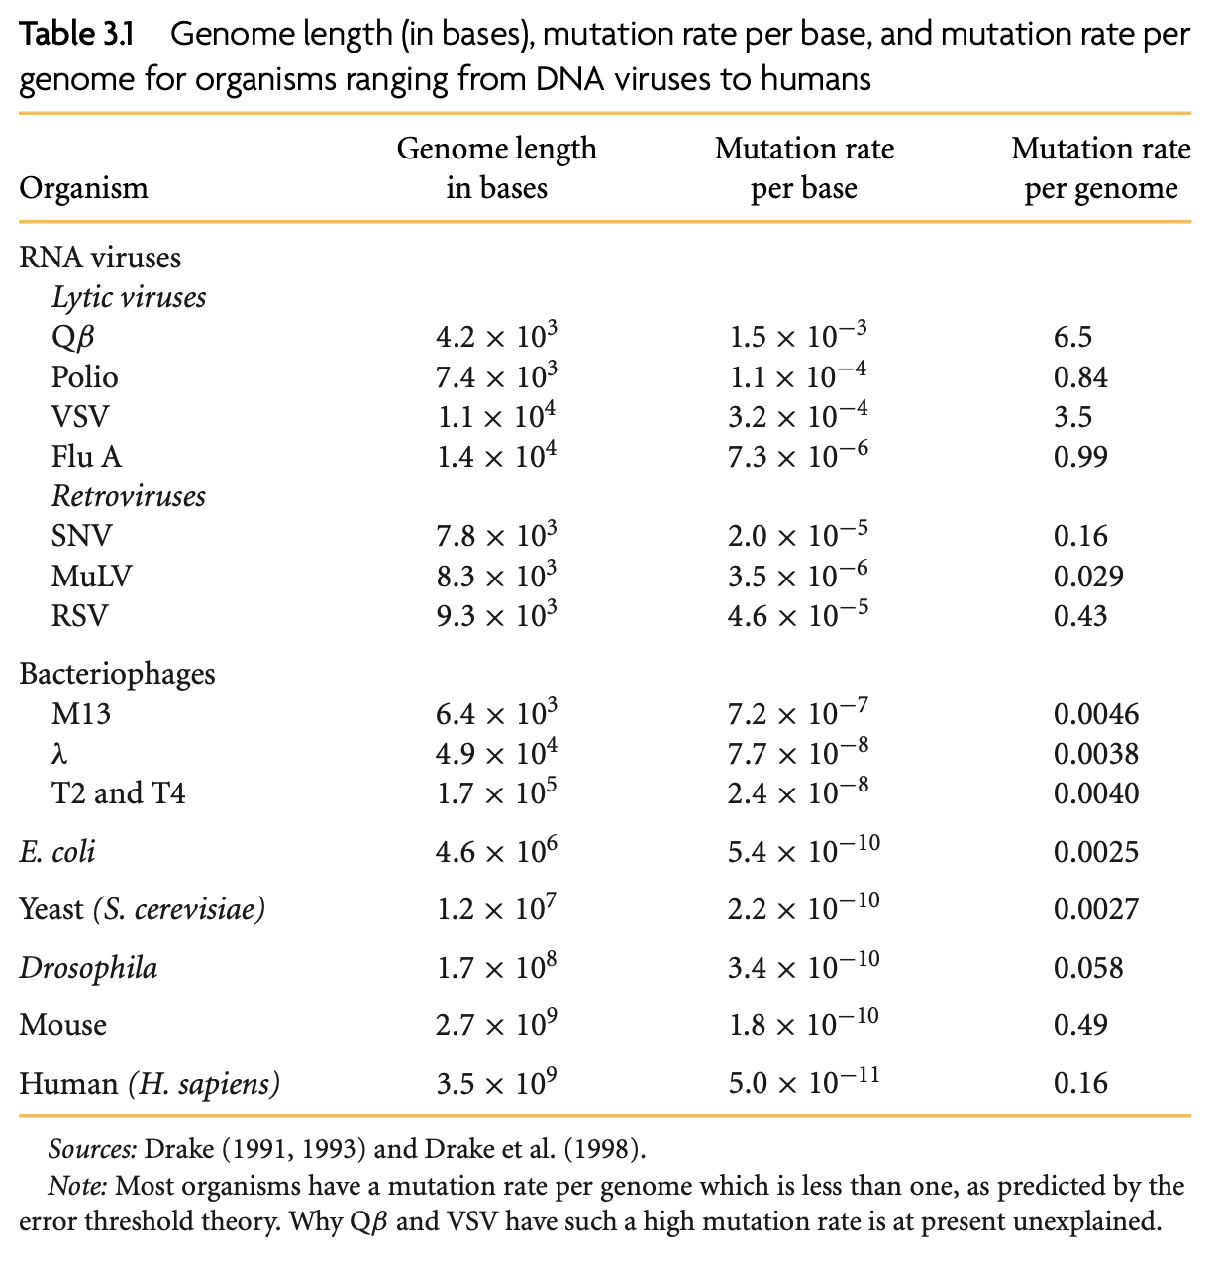
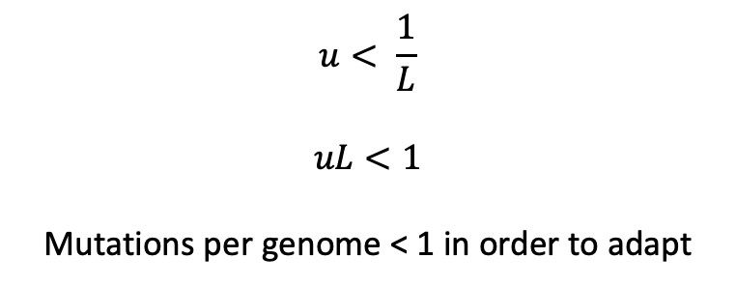
Mutation rates and adaptation
$$u< \frac{1}{L}$$
$$uL<1$$
Mutations per genome < 1 in order to adapt
Nowak, Evolutionary Dynamics

Slide 40
Summary of fitness and adaptation
Selection occurs when organisms have different rates of reproduction
When growth is exponential, selection leads to survival of the fittest
Mutations enable co-existence of strains with different fitness
Quasispecies are populations of genetically related organisms, formed by mutation and selection
There is typically one stable equilibrium of quasispecies, it is often not the fittest but rather a distribution around the fittest
Adaptation cannot occur if mutation rates are too high

Slide 41
Evolution of virulence

Slide 42
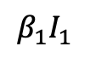
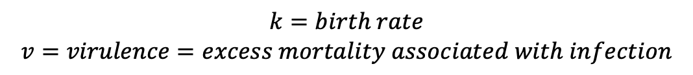
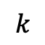

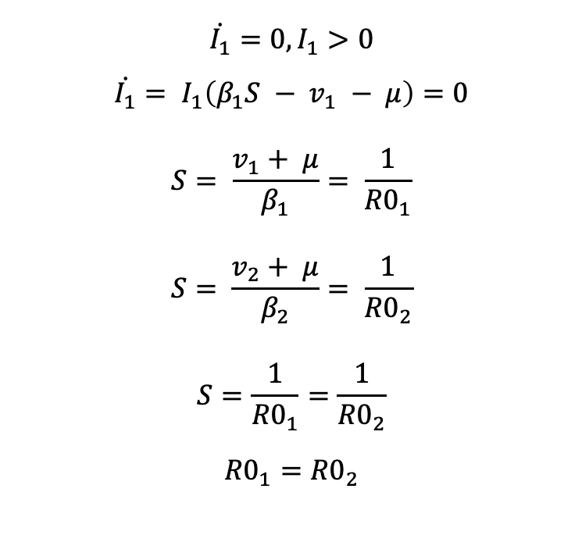
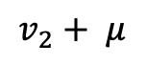
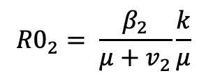



Selection when competing for hosts
$$β_{1}I_{1}$$
I₁
Question: Assuming R0₁ > 1 and R₀₂ > 1, can there be an endemic equilibrium for I₁ and I₂?
$$v_{1}+ μ$$
$$k$$
S
$$\dot{I_{1}}=0, I_{1}>0$$
$${\dot{I_{1}}= I}_{1}\left(β_{1}S − v_{1} − μ\right)=0$$
$$S= \frac{v_{1}+ μ}{β_{1}}= \frac{1}{{R0}_{1}}$$
$$S= \frac{v_{2}+ μ}{β_{2}}= \frac{1}{{R0}_{2}}$$
$$S=\frac{1}{{R0}_{1}}=\frac{1}{{R0}_{2}}$$
$${R0}_{1}={R0}_{2}$$
$$β_{2}I_{2}$$
$$v_{2}+ μ$$
I₂
$$\dot{S}=k −S\left(β_{1}I_{1}+β_{2}I_{2}\right)− μS$$
$$\dot{I_{1}}=I_{1}\left(β_{1}S − v_{1} − μ\right)$$
$$\dot{I_{2}}=I_{2}(β_{1}S −v_{2}− μ)$$
$$k=birth rate$$
$$v=virulence=excess mortality associated with infection$$
$${R0}_{1}= \frac{β_{1}}{μ+v_{1}}\frac{k}{μ}$$
$${R0}_{2}= \frac{β_{2}}{μ+v_{2}}\frac{k}{μ}$$
The only way to have coexistence of two species in full competition for hosts is for equal R_{0.}

Slide 43









Evolution maximizes R₀
$$β_{1}I_{1}$$
I₁
$$v_{1}+ μ$$
$$R_{0}= \frac{β}{μ+v}\frac{k}{μ}$$
$$k$$
Is virulence helpful or harmful to the organism here?
If no constraints, evolution will increase transmission ($β$) and decrease virulence ($v$)
S
$$β_{2}I_{2}$$
$$v_{2}+ μ$$
I₂
What if infectivity is proportionate to virulence?
$$β=av$$
$$R_{0}= \frac{av}{μ+v}\frac{k}{μ}=\frac{ak}{μ}(\frac{v}{v+μ})$$
What if infectivity is a saturating function of virulence?
$$β=a \frac{v}{c+v}, as v→∞, β→a$$
$$R_{0}=\left(a \frac{v}{c+v}\right)\left(\frac{k}{μ}\right)\left(\frac{1}{u+v}\right)$$
$$\frac{dR_{0}\left(v\right)}{dt}=0 to find maximum. Maximum at v=\sqrt{cu}$$

Slide 44
Virulence Summary
When there is competition for hosts, evolution generally maximizes R₀
If virulence and infectivity scale linearly, organisms would increase virulence to their maximum
Usually there are constraints in relationship between virulence and infectivity, such that organisms will evolve towards intermediate virulence to maximize R₀

Slide 45
Superinfection
When a new strain is able to infect a host who is already infected
Leads to:
Higher virulence than optimal for maximizing R0
Co-existence of strains with range of virulence
Fewer infected hosts than without superinfection

Slide 46

Further Reading
Nowak, Evolutionary Dynamics, Chapter 11
Otto and Day, A Biologists Guide to Mathematical Modeling in Ecology and Evolution, Chapter 12

